Slide 1

CMSC 137
Data Communications and Networking
Lecture Module
23 – Domain Name System

Slide 2
Module 23: Domain Name System
Joseph Anthony C. Hermocilla
Lecturer

Slide 3
The need for Domain Name System (DNS)
Names are easier to remember than IP addresses
A system to map a hostname to an IP address or an IP address to a hostname is needed
Approaches
  Approach 1: Use a simple host file with two columns: hostname and IP address
  Approach 2: Dedicate a server to ‘serve’ the large host file (centralized)
  Approach 3: “Split” the host file to be served by multiple servers (distributed)

Slide 4
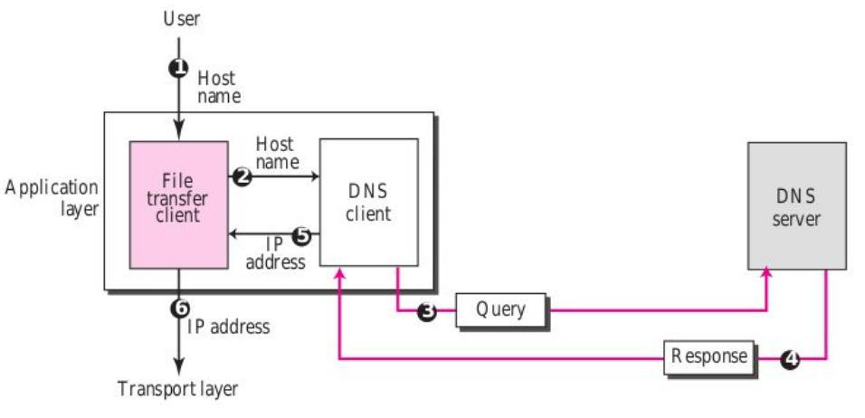
Example: Access a file transfer server given a hostname

Slide 5
Domain Namespace

Slide 6
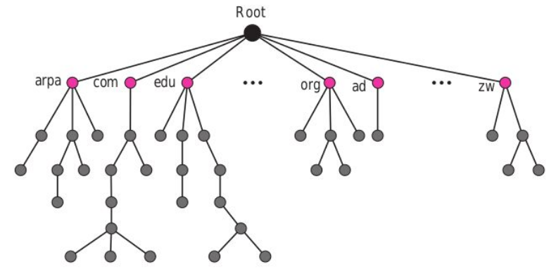
Domain Namespace
Flat – names have no structure
Hierarchical - names have several parts, ex. ics.uplb.edu.ph

Slide 7
Domain Namespace
Tree can have only 128 levels: 0 (root) to 127
Label - assigned to a node in the tree, max of 63 characters
  label for root is the empty string: “”
  children of a node should have different labels
Domain Name (DN) - a sequence of labels separated by dots (.) up to the root that is assigned to each node
  Fully Qualified DN - last character is a dot
  Partially Qualified DN - last character is not a dot

Slide 8
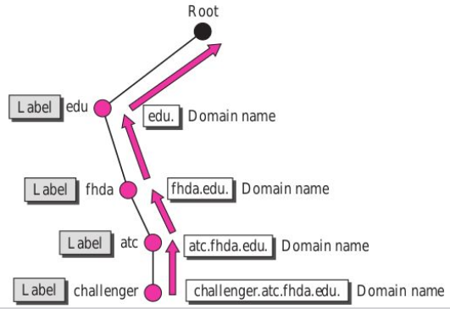
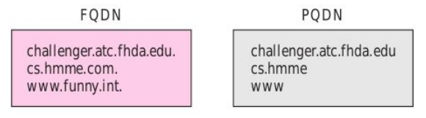
Domain Namespace

Slide 9
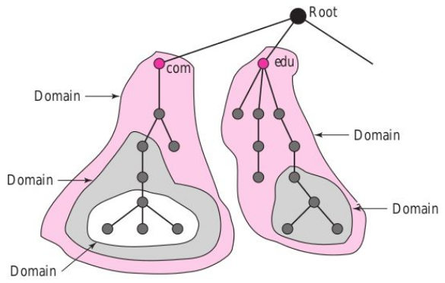
Domain Namespace
Domain
  subtree of the domain namespace
  name of the domain is the domain name of the node at the top of the subtree
  domains may be further divided into subdomains

Slide 10
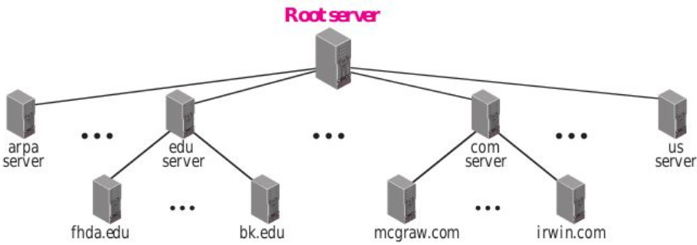
Distribution of Domain Namespace
Information contained in the domain namespace are distributed among many computers called DNS servers, organized hierarchically

Slide 11
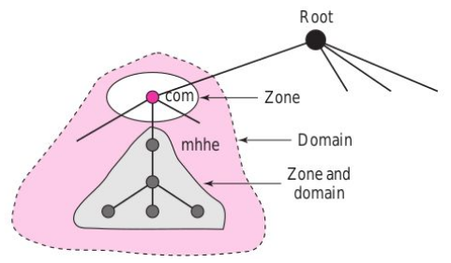
Distribution of Domain Namespace
Zone - a portion of the domain name space that a DNS server has an authority over or is responsible for
Domain and Zone can refer to the same thing if a server does not divide the domain into subdomains
DNS Server maintains a Zone File which keeps all information for every node under that domain

Slide 12
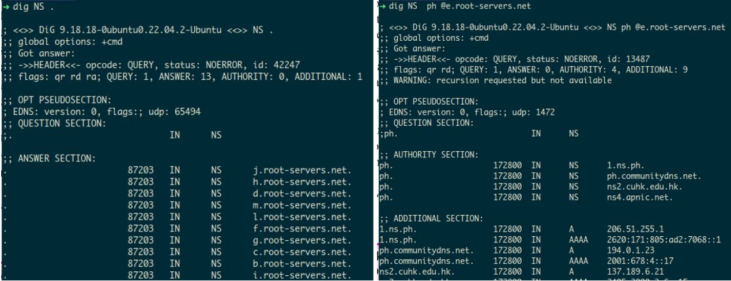
Distribution of Domain Namespace
Root Server - a server whose zone consist of the whole domain namespace tree

Slide 13
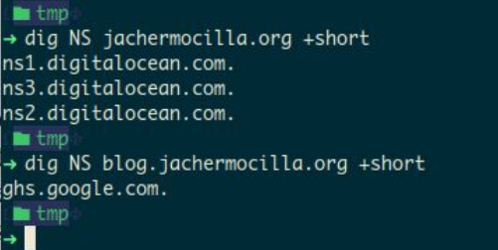
Distribution of Domain Namespace
Primary DNS server - responsible for creating, maintaining, and updating the zone file for which it is an authority
Secondary DNS server - transfers the complete information about a zone from another server (Zone Transfer); does not update the zone file; for redundancy

Slide 14
DNS in the Internet

Slide 15
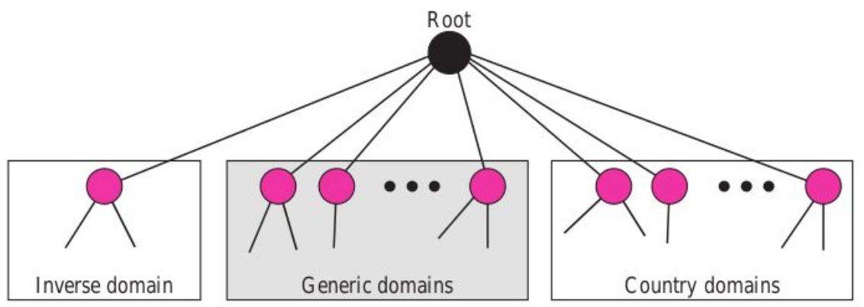
Domains in the Internet
https://data.iana.org/TLD/tlds-alpha-by-domain.txt

Slide 16
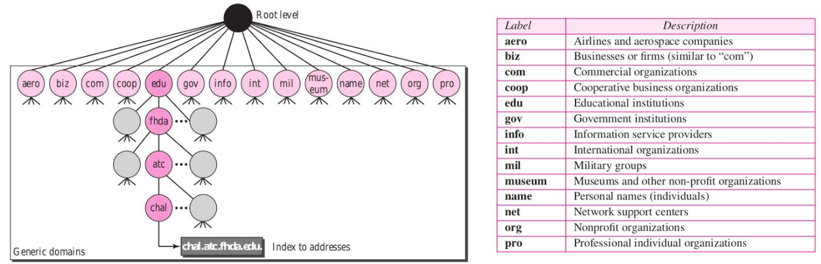
Generic Domains

Slide 17
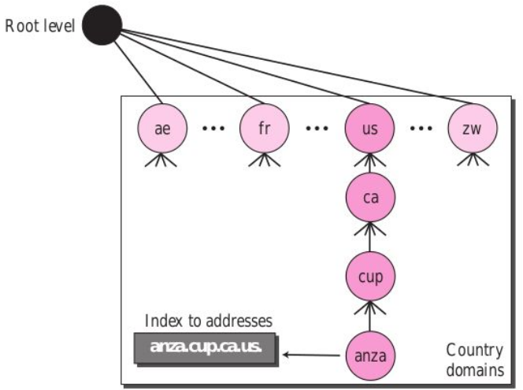
Country Domains

Slide 18
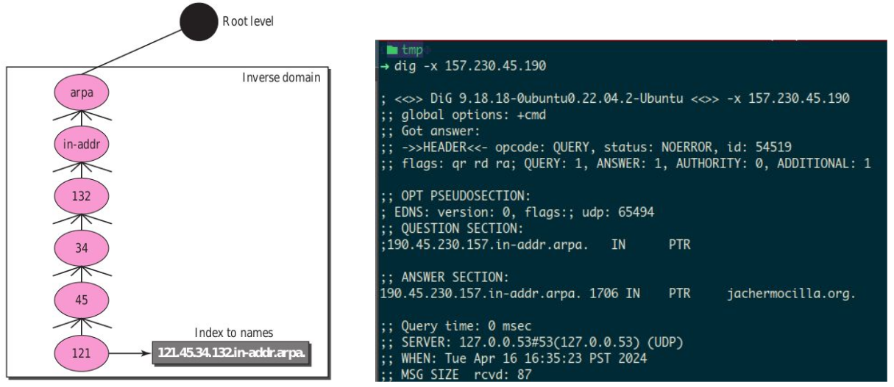
Inverse Domains

Slide 19
Name Resolution

Slide 20
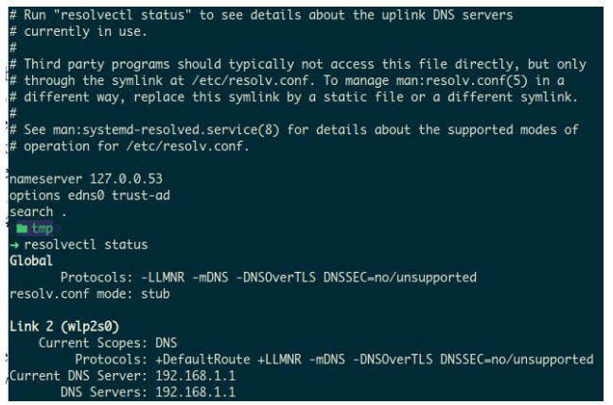
DNS Resolver
Also called a DNS client
checks the cache or contacts a DNS server
  in linux DNS server information is placed traditionally in /etc/resolv.conf
  In modern Linux distros, it is managed by Systemd

Slide 21
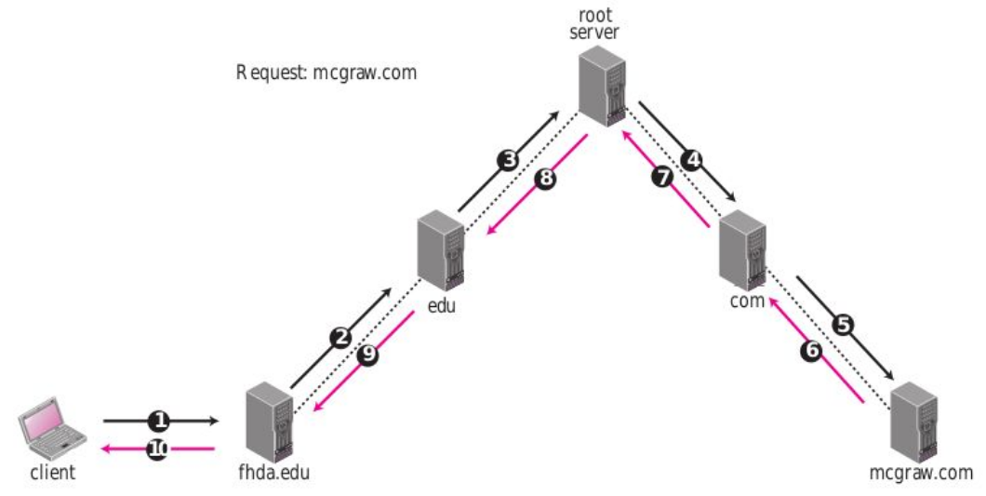
Recursive Resolution
(lola)
(nanay)
(tita)
(anak)
(pinsan)
(you)

Slide 22
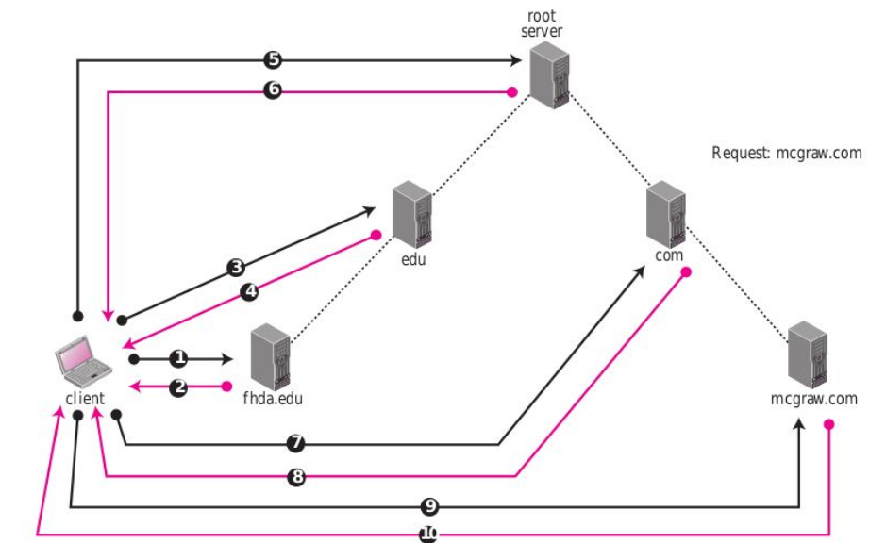
Iterative Resolution
(lola)
(nanay)
(tita)
(you)
(anak)
(pinsan)

Slide 23
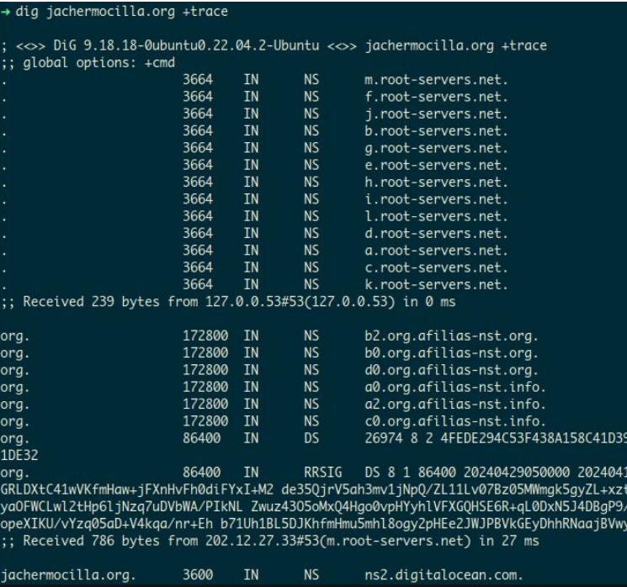
dig +trace

Slide 24
DNS Messages

Slide 25
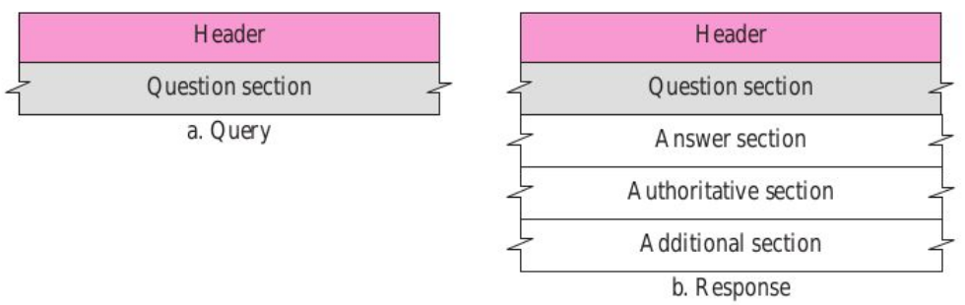
Query and Response Messages

Slide 26
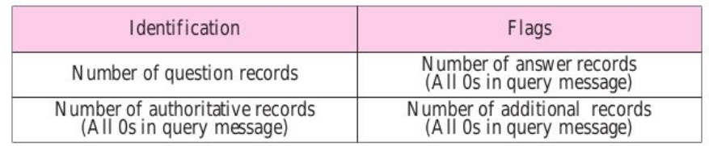
Header
Size is 12 bytes, same for query and response
Identification - 16-bit field use by client to match response with query

Slide 27
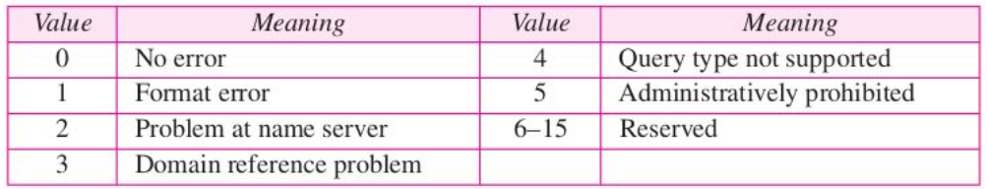
Header
Flags – 16 bits
  QR (query/response) - 0 if query, 1 if response
  OpCode - 4 bits, defines the type of query or response (0-standard, 1-inverse, 2-status request)
  AA (authoritative answer) - 1 bit, 1 if server is authoritative
  TC (truncated) - 1 bit, 1 if response was more than 512 bytes
  RD (recursion desired) - 1 bit, 1 if recursive answer is desired
  RA (recursion available) - 1 bit, 1 if recursive is available
  Reserved - three 0’s
  rCode - 4 bits

Slide 28
Types of Records

Slide 29
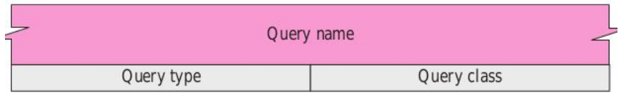
Question Record
Used by client to get information from server

Slide 30
Question Record
Query Name

Slide 31
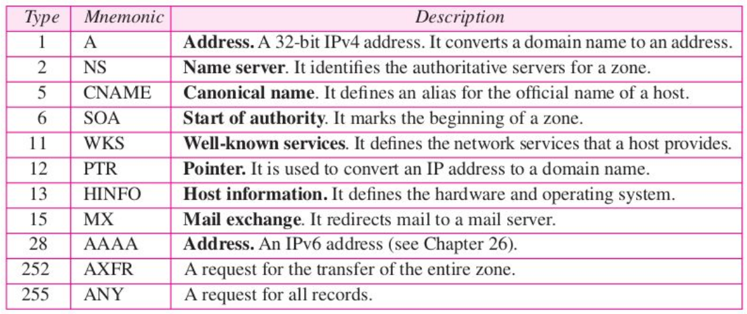
Question Record
Query Type

Slide 32
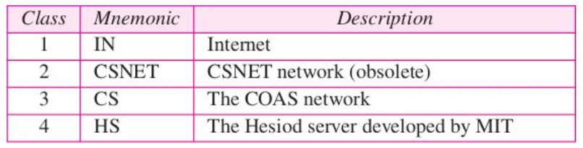
Question Record
Query Class

Slide 33
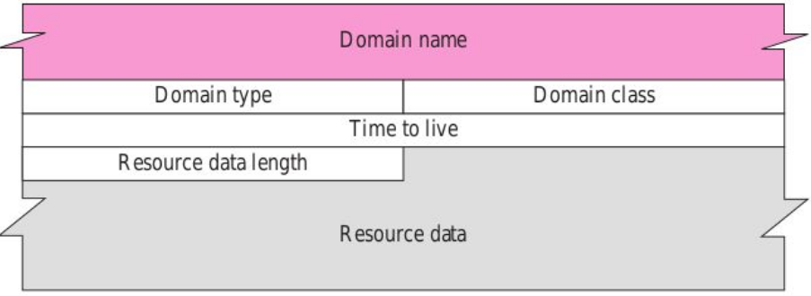
Resource Record
Associated with each domain name is a Resource Record

Slide 34
Resource Record
Domain name - same as from question record
Domain type - same as query type field in question record
Domain class - same as query class field in the question record
Time-to-live - 32-bit fields that the number of seconds the answer is valid, 0 means not cached
Resource data length - 16 bits to define the length of resource data
Resource data - variable length containing the answer to the query: number, domain name, offset pointer, character string

Slide 35
References
Forouzan, B.A. 2013. Data Communications and Networking, 5th Ed. McGraw-Hill, New York.

